Slide 1

Welcome

Slide 2
Introduce
Teacher
Lesson
Mohammad Ruhullah
Asst. Teacher in English
Narandi High School
Pakundia , Kishoregonj
Class----------- 9
Sub. ----------- English
Unit ---------- 8
Date -------- 13-02-2014

Slide 3
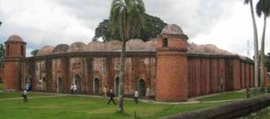

Slide 4
The shat Gambuj Mosque

Slide 5
Learning outcomes
Listen for specific information.
Read and understand text through silent reading.
Ask and answer questions.
Describe a place.

Slide 6
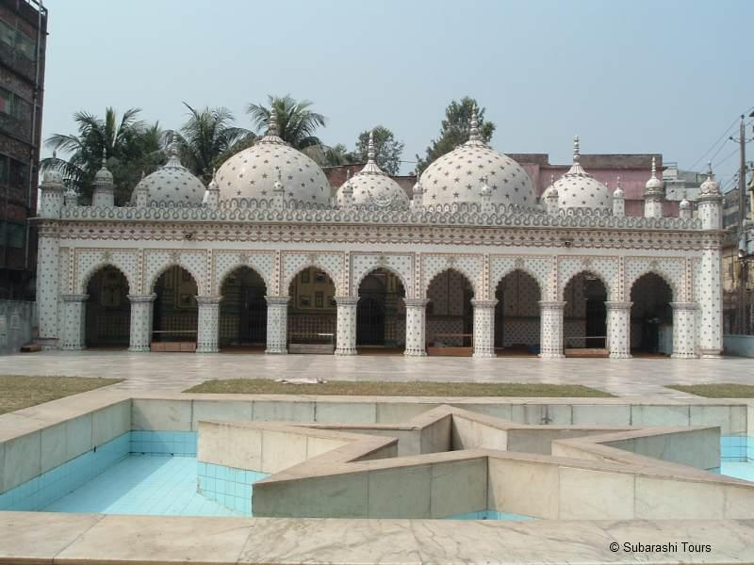

Slide 7
Words Meanings
Heritage
Monument
Mangrove
Architecture
Remarkable

Slide 8
Group Work
Complete the chart
Shat Gambuj Mosque | Information
Founded by
When
Number of domes
Number of pillars
Arches
Mihrabs

Slide 9
Evaluation
When the Shat Gambuj Mosque was built?
Who was built it?
How many doorways in the mosque?
Which purpose the mosque was used?
What was the previous name of Bagerhat?

Slide 10
Home task
Write a paragraph about ‘‘Your village Mosque’’ within 10 sentences.

Slide 11

Thanks
No more Today.

